Slide 1
Histogram
Lab 4

Slide 2
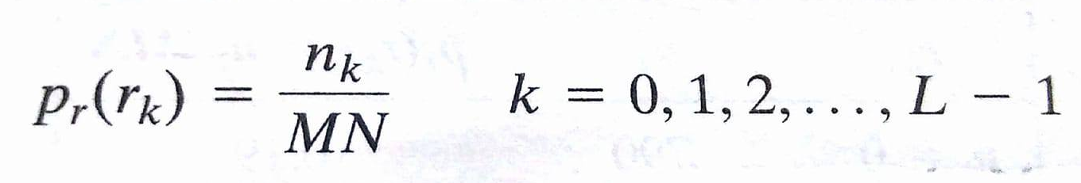
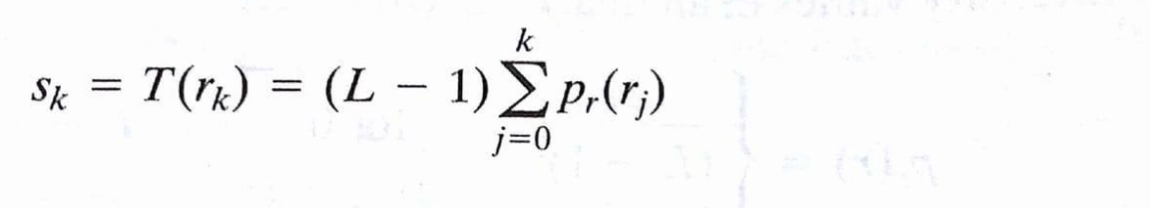
Histogram Equalization
For discrete values we deal with probabilities and summation instead of PDF and integrals

Slide 3
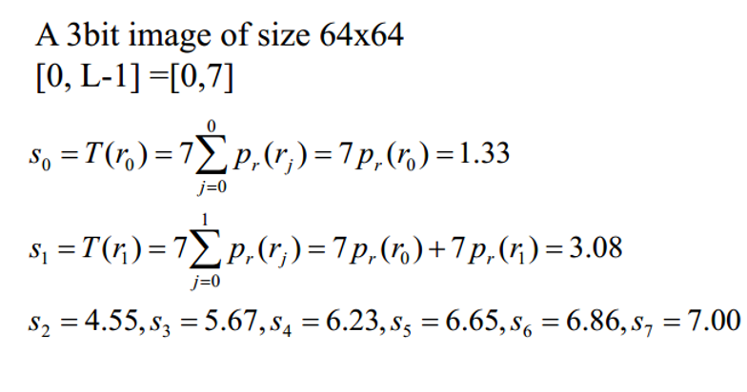
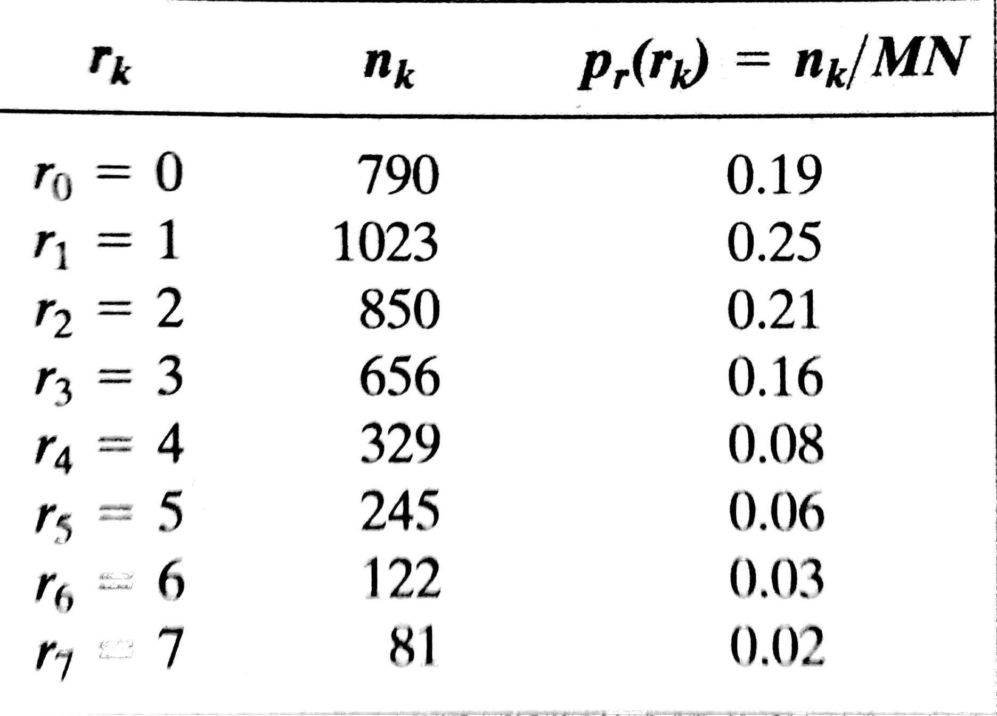
Example

Slide 4
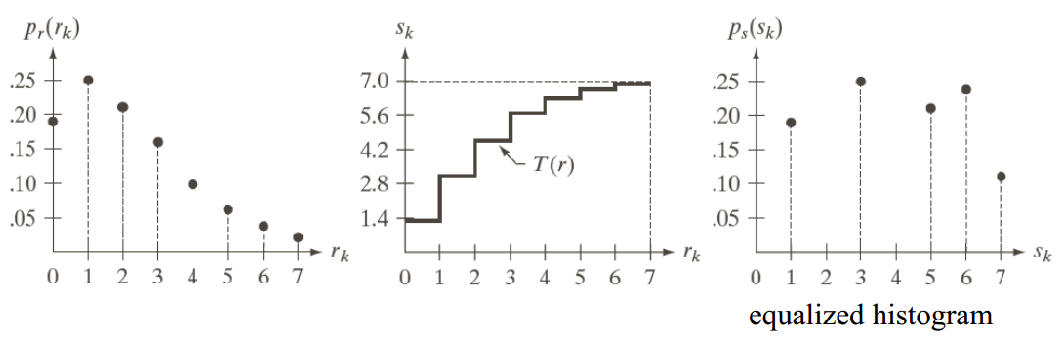
S0 = 1.33 = 1
S1 = 3.08 = 3
S2 = 4.55 = 5
S3 = 5.67 = 6
S4 = 6.23 = 6
S5 = 6.65 = 7
S6 = 6.86 = 7
S7 = 7.00 = 7

Slide 5
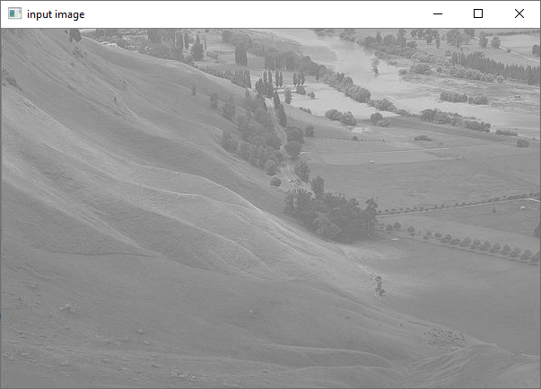
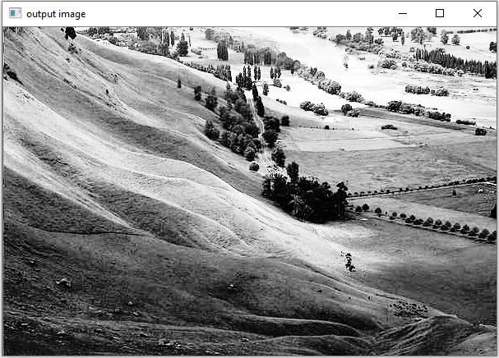
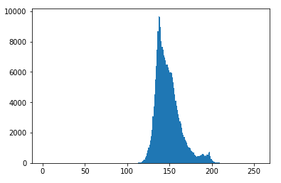
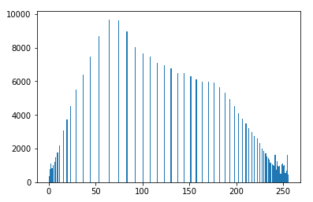

Slide 6
Assignment
Erlang distribution
The Erlang distribution is a two-parameter family of continuous probability distributions
Shape parameter (k)
Rate parameter (λ)
The ‘scale parameter’, µ the reciprocal of the rate parameter

Slide 7
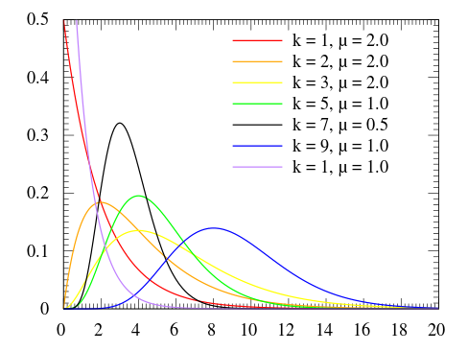

Slide 8
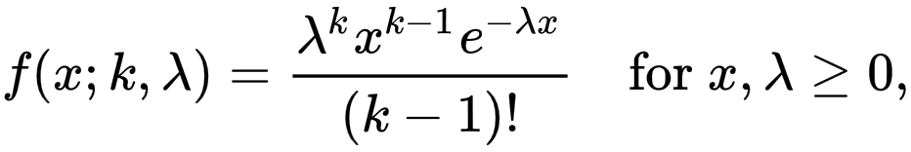
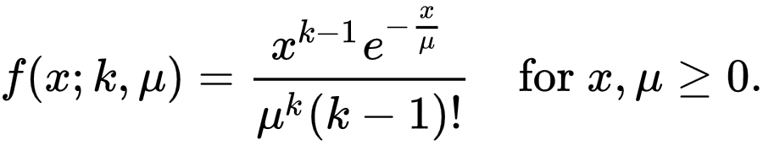

Mean =

